Slide 1



M E N T A L M A T E
Team
Raghav Krishna Kumar (x18181848)
Vinaysheel Kishor Wagh (x18194303)
Shrey Sanjay Shah(x18192271)
Kamalesh Palani (x18180311)

Slide 2
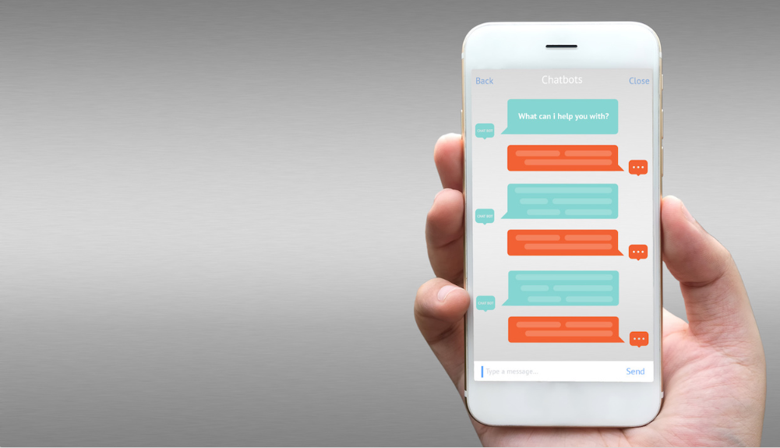
Vision
On a Mission to revolutionize Mental health assistance through chatbot using Artificial Intelligence by giving users a natural user interface .

Slide 3

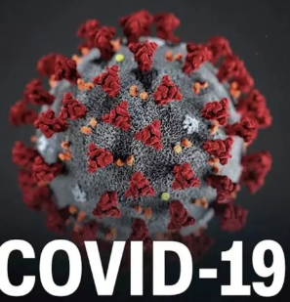

Problems
Anxiety
Pandemic outbreak
Depression

Slide 4


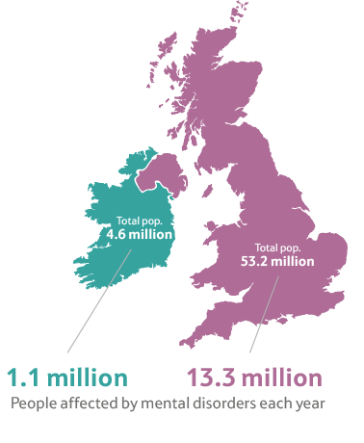
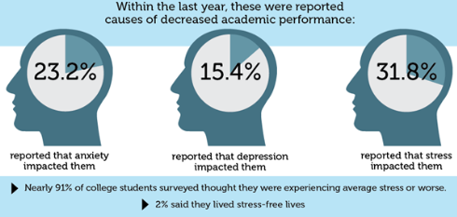
Market Size
Market Size

Slide 5

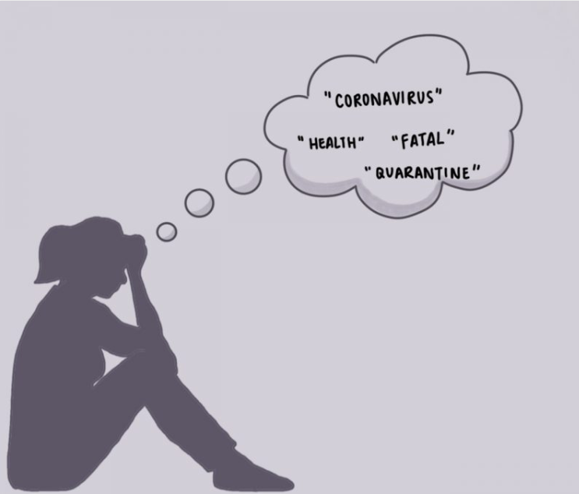
Early Adopters
Early Adopters
Student’s facing Mental Health Issues
COVID-19 affected Students

Slide 6




Challenges
Challenges
Scripted
Customer Privacy
High Rates
Trusted Healthcare Professionals

Slide 7



Unique Value Proposition
Why are we better ?
24/7 Customer Support
Low Rates
Trusted Healthcare Professional
User Privacy

Slide 8
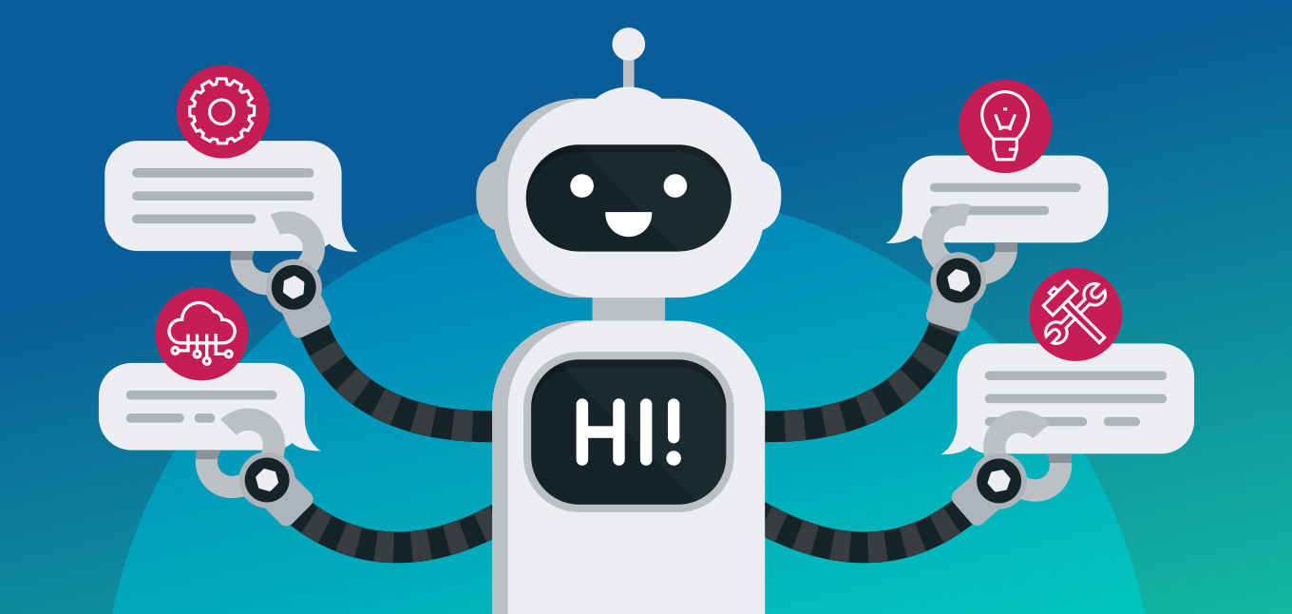





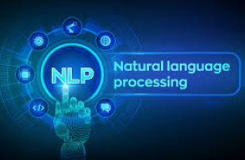
How we work
How we work?
A.I based Mental Health assistant powered by Dialog flow
Sophie will be getting a first line support and the instructions from the mental mate bot
Sophie is a master’s student. She is depressed due to covid-19 and assignment submission.
If Sophie is a subscribed user she can book or chat with the health care professional.

Slide 9
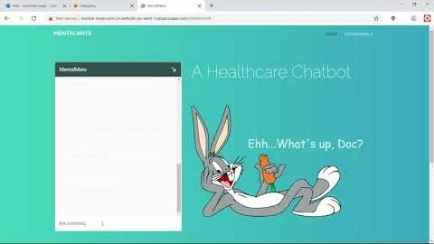
Product Demo - 1 (Covid-19)
With Audio

Slide 10
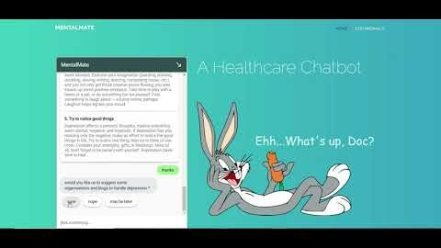
Product Demo - 2 (Depression)
How we work?

Slide 11
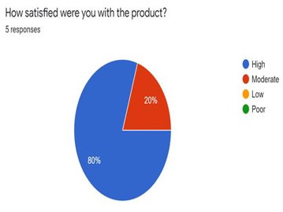
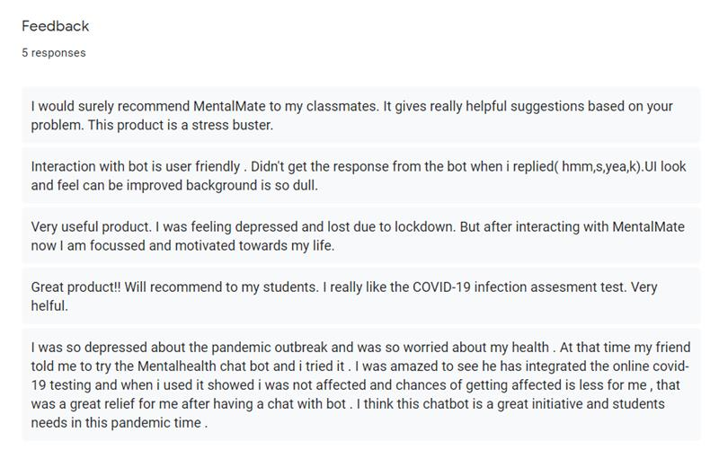
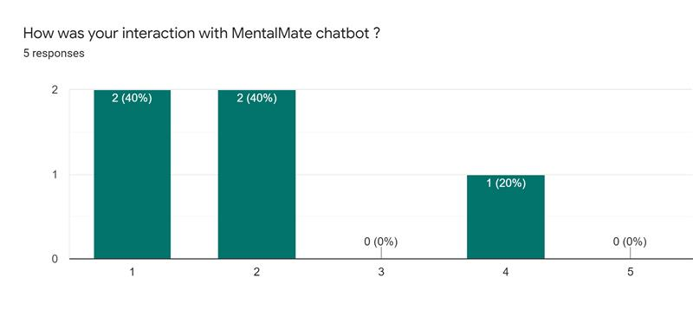
User Feedback
How we work?

Slide 12






Competition
Competitors
Affordable
Low Interaction
High Interaction
Expensive

Slide 13



Revenue Model
Revenue Model
Subscription
Ad Serving
Revenue
Model
Institutional Tie-Up

Slide 14
Business model
Business Model
 | Basic | Standard | Pro
Duration | 30 days | 30 days | 30 days
Monthly fee | 14.99 €/month | 150.99 €/month | 599.99 €/month
One to One sessions | N/A | 5 sessions | Unlimited
Communication | Chatbots | Assistance from healthcare professionals (1-3 years experience) | Assistance from healthcare professionals (5+ years experience)
Availability | 24/7 chatbot service | 24/7 dynamic chatbot service | 24/7 dynamic chatbot service
Number of sessions | 100 replies/day | 1000 replies/day 5 one to one sessions/month | Unlimited replies/day Unlimited one to one sessions

Slide 15
Milestone
Alpha Test
Create prototype (Mini mum viable product MVP) and validate implementation (feasibility study)
Web App Launch
Implement web version of the chat bot and launch.
Seed
Apply to accelerators, funding and early stages VCs.
1
3
5
Beta Test
Develop good UX, Gather feedback from beta testers.
Go to Business
Create and validate business plan , pitch deck etc.
Add first customers.
2
4

Slide 16
Investments & Projections
Investing
Currently Raising € 8 Million

Slide 17





Marketing Plan
Marketing Plan
Email Campaign
Educational Institutions
Social Media
Referral
Advertisement

Slide 18
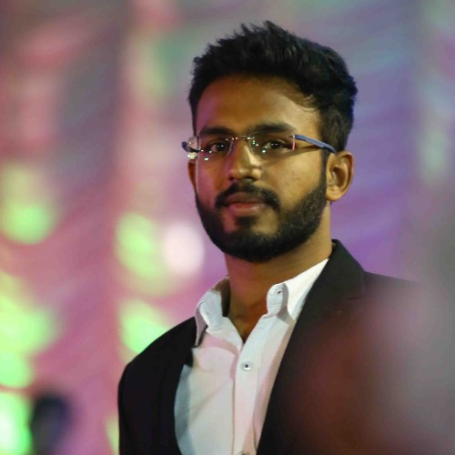
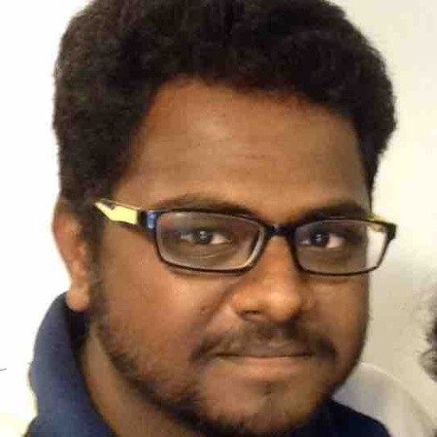
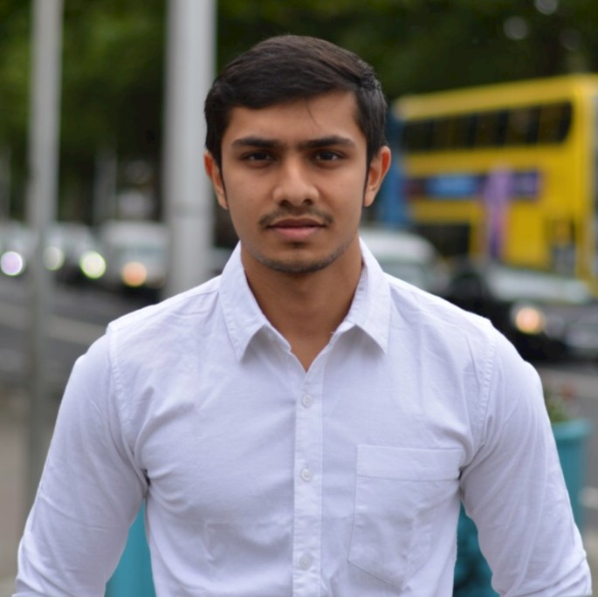
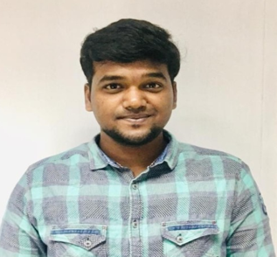
Team
Team
Founder & CEO Creative Director CTO CMO
Kamalesh Palani
(x18180311)
Vinaysheel Kishor Wagh
(x18194303)
Raghav Krishna Kumar (x18181848)
Shrey Sanjay Shah
(x18192271)
Market research
Feasibility analysis
Web-app implementation
Technical architecture
Chatbot implementation
Revenue strategy
Statistical research
Chatbot development
Marketing strategy
Finance overview
Competitors case study
Business Model

Slide 19
THANK YOU !

